Slide 1
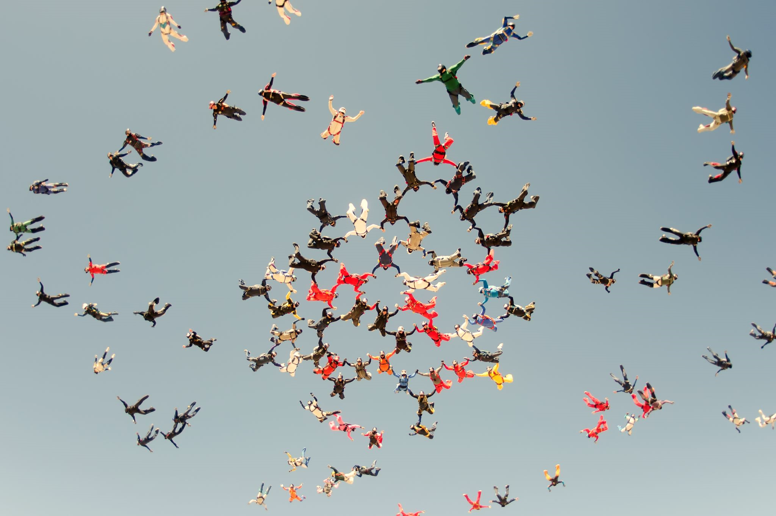

Predicting and preventing Customer Attrition
Saroj Raut
Bellevue University

Slide 2
Introduction and Background
Customer attrition means that a customer stops his or her business relationship with a company. It is the loss of customers by a business. Businesses classify a customer as churned(inactive) after a certain period when the customer is not active or make any transaction from the company. By losing customers, the business loses both revenue and the marketing costs involved in replacing them with new customers.

Slide 3
Problem Statement
The purpose of this project is to develop an AI model for looking into customer activity and pattern to provide customers that are at risk of likely to leave soon. The model provides customers that are at risk or will likely leave soon by looking into customers activity and pattern. The model also provides LOB an ability to utilize model output data for identifying merchants at risk, finding microsegments of merchants at risk, and develop corrective action to lower attrition.

Slide 4
Scope
2018 Churn modeling data from Kaggle site will be used for the prediction of customers at a Bank.
Perform exploratory data analysis.
Data will be cleansed before model selection.
Identify and visualize which factors contribute to customer churn.
Predict the probability of a customer who is likely to attrite using machine learning techniques
Classify if a customer is going to churn or not.

Slide 5
Exploratory Data Analysis
Goal: get a general sense of the data
- shape, distribution, data type, summary.
Data Discovery and Analysis using Python, R, and Visualization.
Bottom line: it is always well worth looking at your data.

Slide 6
Methods
The data set offered information on variables such as:
'Status' relation with categorical variables.
Understand how the given attributes relate to the ‘Exit’ status.
Relations based on the continuous data attributes.
Arrange columns by data type for easier manipulation.
Data prep pipeline for test data.

Slide 7
Results of data understanding
About 20% of the customers have churned.
Majority of the data is from France.
There is more female customers churn than that of male customers.
Most of the customers that churned are those with credit cards.
Inactive member have a greater churn than the customers that are active.
Neither the product nor the salary has a significant effect on the likelihood to churn.

Slide 8
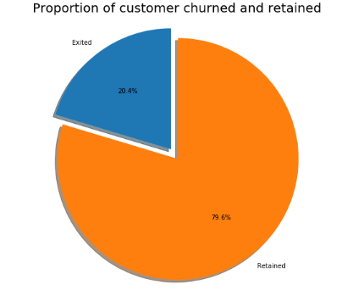
Graph Analysis

Slide 9
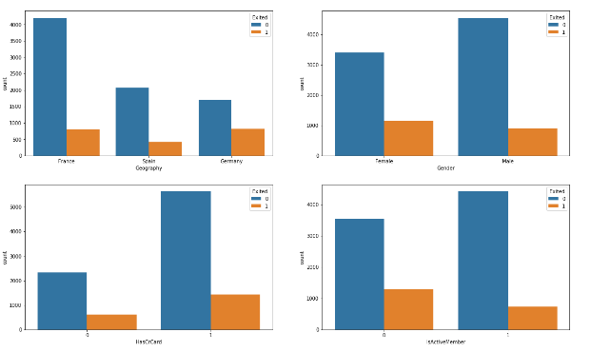
Graph Analysis

Slide 10
Question from the Analysis
The data appears to be a snapshot as some point in time e.g. the balance is for a given date which leaves a lot of questions:
What date is it and how relevant is this date?
Would it be possible to obtain balances over a period as opposed to a single date?
There are customers who have exited but still have a balance in their account! What would this mean? Could they have exited from a product and not the bank?
What does mean be an active member mean? and are there difference degrees to it? Could it be better to provide transaction count both in terms of credits and debits to the account instead?
A break down to the products bought into by a customer could provide more information topping listing of product count.

Slide 11
Feature Engineering
Add features that are likely to have an impact on the probability of churning.
Split the train and test sets
Data prep for model fitting
Categorical variable
Continuous variable

Slide 12
Model fitting and selection
Logistic regression
SVM in the primal and with different Kernels
Ensemble models
Review best model fit accuracy
The performance in predicting 1's (Customers who churn)

Slide 13
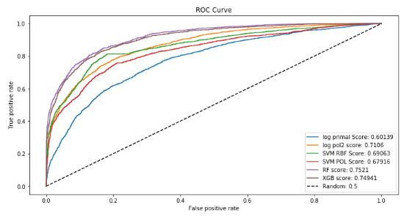
Performance measurement

Slide 14
Model deployment
From the review of the fitted models above, the best model that gives a decent balance of the recall and precision is the random forest where according to the fit on the training set, with a precision score on 1's of 0.88, out of all customers that the model thinks will churn, 88% do actually churn and with the recall score of 0.53 on the 1's, the model is able to highlight 53% of all those who churned.

Slide 15
Conclusion
In conclusion it can be said that the Business needs to update and upgrade their business as per the changing needs of the market. To gain a competitive edge in the market, it is necessary to focus on areas that are identified as risk and take necessary corrective actions for it.

Slide 16
References
https://blog.hubspot.com/service/what-is-customer-churn
https://www.optimove.com/resources/learning-center/customer-churn-prediction-and-prevention
https://www.datacamp.com/community/tutorials/predicting-employee-churn-python

